Slide 1
Creativity in
Learning & Teaching
W Davies & L Brown

Slide 2

What is creativity?

Slide 3
Creativity
Using the imagination
Develop originality, play with & actually try out new ideas
Making choices & taking risks
Real audience & purpose, worthwhile activity
Notes:
Luke

Slide 4
Learning Agenda
Develop knowledge and understanding of creative:
Use of ICT
Learning challenges / tasks
Assessment for Learning
Student roles

Slide 5
Creative use of ICT
Podcasting
Students collating information to create an audio file (MP3) which can summarise learning or raise key questions. Examples could be:
Teachers uploading summaries / homework tasks / exam technique
Students designing end of topic revision
Students debating different points of view

Slide 6
Thinking about Podcasting
What are the benefits of podcasting?
How can it stimulate creativity in learning and teaching?

Slide 7
Podcasting
Benefits | Creativity /PLTS
Inclusion – visually impaired students / dyslexic students | Teamwork
Technically easy to do with free software such as Audacity | Enterprise
Can save time! | Production (noises, background effects)
Media approach catches students interest | Students leading learning
Opens up learning outside the classroom | AfL

Slide 8
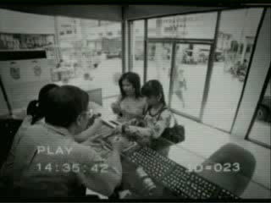

Creative ICT – You Tube!

Slide 9
When would you use that clip in a lesson?

Slide 10
Creative ICT
Blogging
"A blog is a personal diary. A daily pulpit. A collaborative space. A political soapbox. A breaking-news outlet. A collection of links. Your own private thoughts. Memos to the world."
Blogger.com

Slide 11
Learning Blogs
Online dialogue between learners (and that includes you….important to show students we are still learning)
Blog Posts can be:
  Thought / Idea
  Media Clip (YouTube)
  Links to Newspaper article
  Evaluation / Hypothesis Stem
  Student designed
  Student work

Slide 12
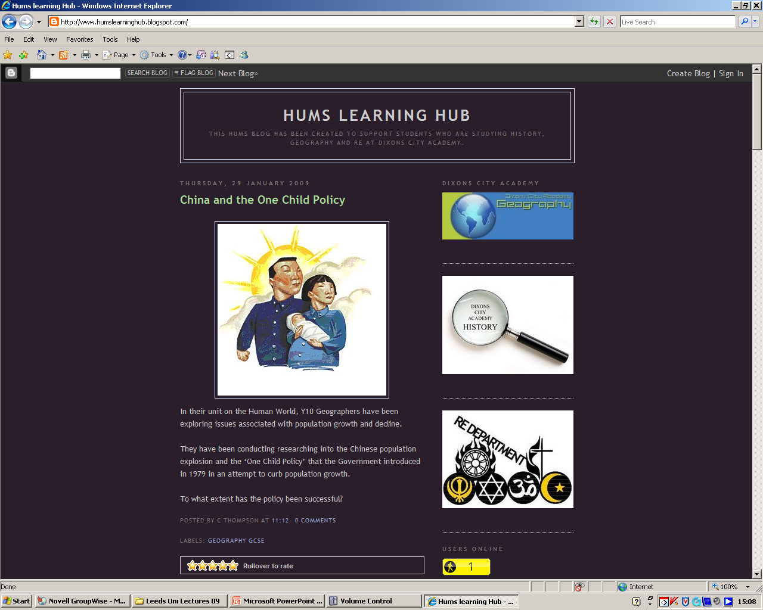
Example of a curriculum Blog

Slide 13
Blogging
Benefits | Creativity /PLTS
G&T provision | Real audience
Valuing every learner | Show casing student work
Dealing with sensitive issues | E-learning
Rewards | AfL

Slide 14
Learning Agenda
Develop knowledge and understanding of creative:
Use of ICT
Learning challenges / tasks
Assessment for Learning
Student roles

Slide 15
Creative learning challenges
Learning should be fun but based on students developing learning, personal and thinking skills
Thinking skills are one method of ensuring that students are being challenged by the learning episode and stimulate a real ‘buzz’ in the classroom
Always have high expectations of students and then provide the support / scaffolding for students to rise to and meet your expectations

Slide 16

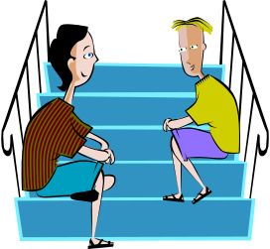
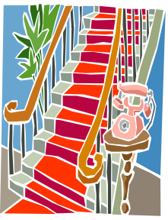
Challenge in lessons
Evaluate, imagine, predict, apply a principle, generalise, judge, speculate, If/then.., hypothesise, forecast, idealise
Applying
Processing
Compare, sort, reason, contrast, explain (why), classify, distinguish, infer, sequence, analyse, synthesise, make analogies, reason
Gathering
Observe, describe, name, tell, list, count, complete, define, identify, match, recite, select, scan

Slide 17

MONARCHS BIG BROTHER

Slide 18
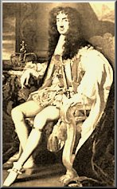
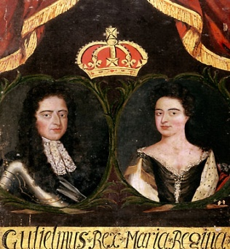
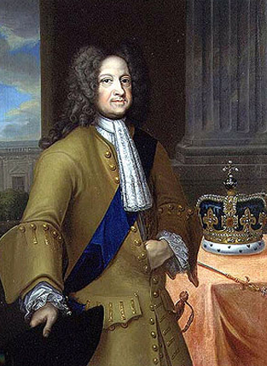
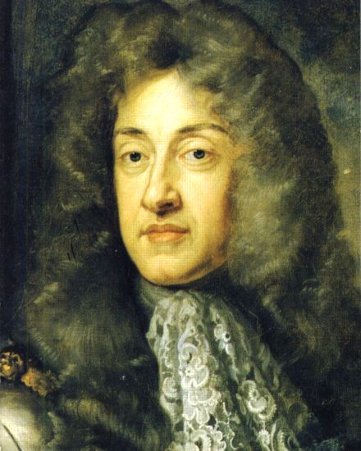
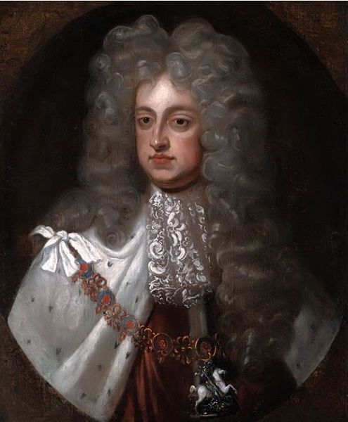
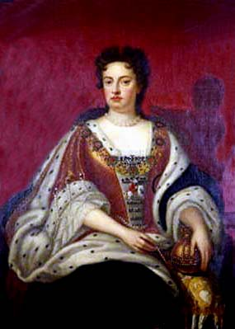
Who goes? You decide!
William and
Mary
George I
Charles II
Anne
James II
George II

Slide 19
Monarch’s Big Brother: who goes? You decide!
I, Charles II, should stay in the Big Brother Monarch’s house because….
During my reign I….
And this made me strong because…
Others might say…….but…..
If I hadn’t……then……
If we compare me to others such as……it’s clear that I was stronger because……
Overall I should win because…..
Charles II

Slide 20
The Challenge
Evaluate, imagine, predict, apply a principle, generalise, judge, speculate, If/then.., hypothesise, forecast, idealise
Applying
Processing
Compare, sort, reason, contrast, explain (why), classify, distinguish, infer, sequence, analyse, synthesise, make analogies, reason
Gathering
Observe, describe, name, tell, list, count, complete, define, identify, match, recite, select, scan

Slide 21
Time to think!
Discuss with someone near you how you could use a similar exercise in your subject area!

Slide 22
Creative Challenges – the menu
Big Brother debates - most important / relevant
Wonderwalls
Mysteries
Human continuum
Finding the question
Living graphs
Collective memories / Maps from Memories

Slide 23
Learning Agenda
Develop knowledge and understanding of creative:
Use of ICT
Learning challenges / tasks
Assessment for Learning
Student roles

Slide 24
Creative Assessment for Learning
Use of learning objectives
Students guessing objectives at the end of the lesson
Student designed objectives
Student voting on confidence levels with objectives
Students ranking objectives to importance

Slide 25
Creative Assessment for Learning
Understanding success criteria
Students designed levels / descriptors
Students re-arranging levels / descriptors as a learning challenge
Students designing assessment tasks and debriefing the success of these
Peer and self assessment opportunities

Slide 26
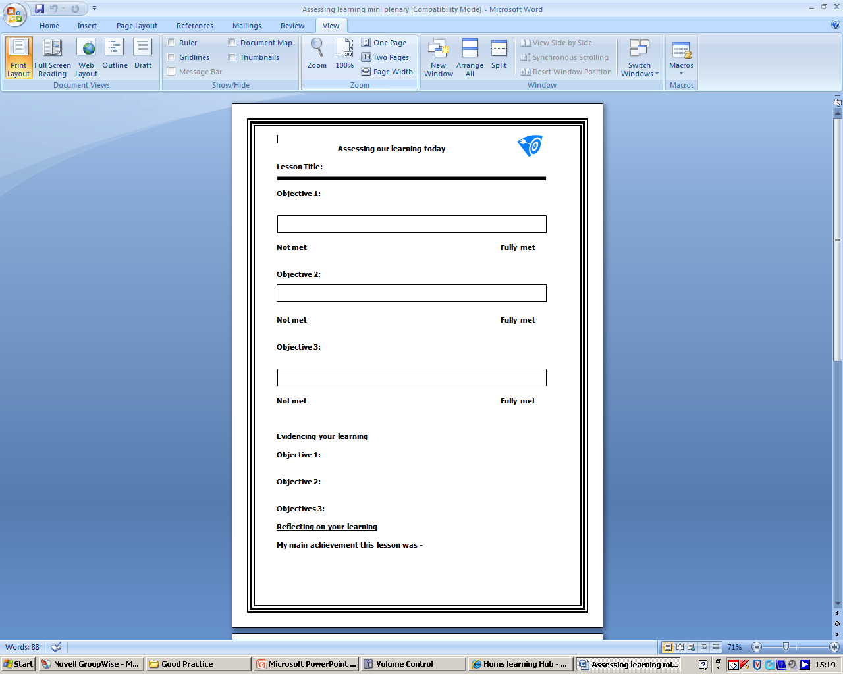

Slide 27
Three things you’ve learnt
Two things you already knew
When can this be used?
One question
Notes:
Rachel

Slide 28
Learning Agenda
Develop knowledge and understanding of creative:
Use of ICT
Assessment for Learning
Student roles
Learning challenges / tasks

Slide 29
Creative student roles
Creativity in learning often starts with the teacher making learning student centred and focussed
Learning is most powerful when students are actively engaged in the process and take ownership of their own learning journey
Creative use of AfL allows students to do this including changing roles with the teacher sometimes

Slide 30
Plenaries
Students can….
reflect on and consolidate their learning
hear alternative explanations and methods
make wider links
evaluate and assess their own progress
gain self esteem
Staff can….
assess students understanding and confidence
identify and correct misconceptions
accurately plan future learning
involve all students in learning process
add structure and pace to lesson

Slide 31

Benefits of student plenaries
Keen focus on lesson objectives
Variety!
Ownership of learning – taking responsibility
Self esteem – being the ‘expert’
Modelling good practice
A way to involve and reward all students
Creativity – taking advantage of their good ideas!
Assessing learning styles

Slide 32

Successful student plenaries
When to use / how often
Choosing students carefully
Prepare and give time
Praise and reward
Have a back up!

Slide 33
Menu of activities
Quiz: straightforward Q&A (merits!)
Millionaire
Mini-whiteboards
Picture summaries (BOB or pictionary)
Class surveys / voting
Role play / mime / tableau
Odd ones out
Who am I? Post-its
Summary motto / tag line
Hangman
True / false (stand up / sit down or move around room)
Cloze / fill in the blanks

Slide 34
Students views

Slide 35
Learning Agenda
Develop knowledge and understanding of creative:
Use of ICT
Learning challenges / tasks
Assessment for Learning
Student roles

Slide 36
Professional Reflection
What strategies / tools can use to make your teaching and your students learning more creative?
Which one of these is a professional priority for you?
Blogging Podcasting Creative challenges
AfL Student centred learning

Slide 37
Thank you
&
good luck!

Slide 38
WD & LRB: Things to do
Big brother music to go on slide introducing creative learning challenges

